Slide 1
Tutorial 1B
SVM

Slide 2
Example: Credit Ratings
The data set contains financial ratios, industry sector, and credit ratings for a list of corporate customers. This is simulated, not real data. The first column is a customer ID. Then we have five columns of financial ratios.
Working capital / Total Assets (WC_TA)
Retained Earnings / Total Assets (RE_TA)
Earnings Before Interests and Taxes / Total Assets (EBIT_TA)
Market Value of Equity / Book Value of Total Debt (MVE_BVTD)
Sales / Total Assets (S_TA)
Next, we have an industry sector label, an integer value ranging from 1 to 12. The last column has the credit rating assigned to the customer. We load the data into a table array.
creditDS = readtable('CreditRating_Historical.dat');

Slide 3
Import the training set data from file CR2.xlsx
Go to the import data menu in the home tab, an import window will appear (see exibit 1)
Choose the CR2.xlsx file
Choose the range from A1 to I3932
Select the Output Type to be Numeric Matrix
Go to Import Selection and choose Import Data
A matrix CR2 will appear in the Workspace Window

Slide 4
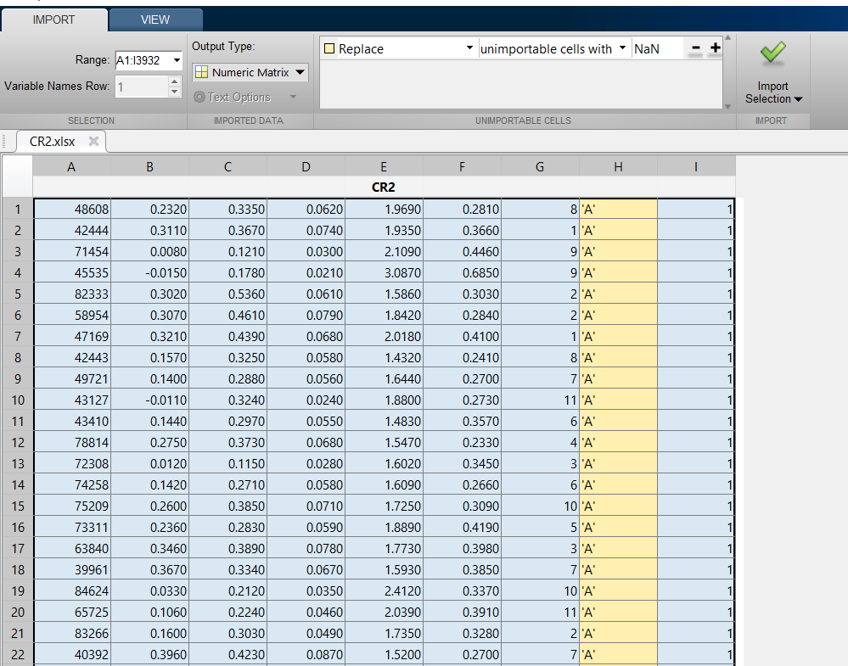
Exhibit 1

Slide 5
Importing the training set from the Workspace to Classification Learner
In the Apps tab choose Classification Learner
A window will appear. Choose New Session
A New Session Window will appear (Exhibit 2)
Uncheck column 1 because it contains company ID that has obviously no relationship with the credit quality
Column 8 is automatically unchecked because it has rating information in a character string format
The response variable is in column 9 and has one of the two values: 1 or -1.
For Validation choose No Validation option
Press Start Session button

Slide 6
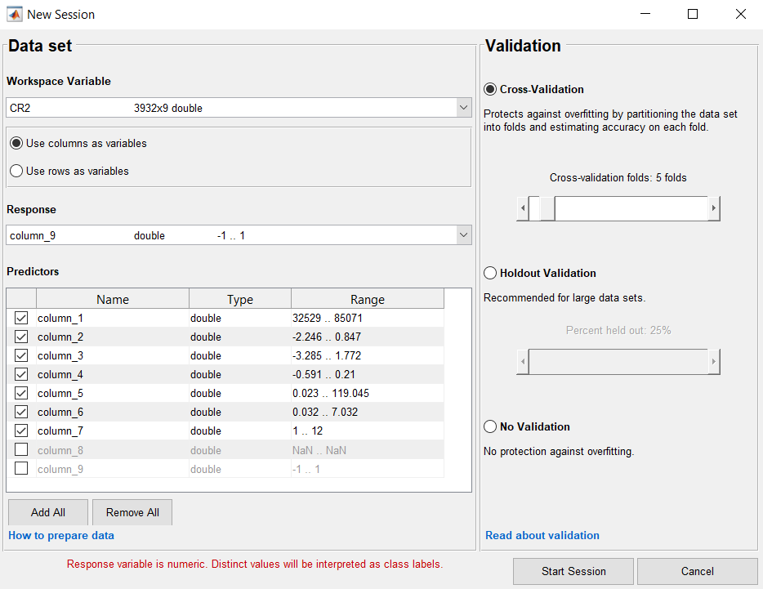
Exhibit 2

Slide 7
Choose Learning Model Type
A new window will appear (Exhibit 3)
By default the Learning Tree Model will appear. To override, go to the black triangle menu (left od Advanced menu). Choose All SVMs option (Exhibit 4).
Press the green Train button.
SVM models with different available kernels will appear on the left hand and start showing achieved accuracy score. The model with the highest score will be automatically selected (Exhibit 5).

Slide 8
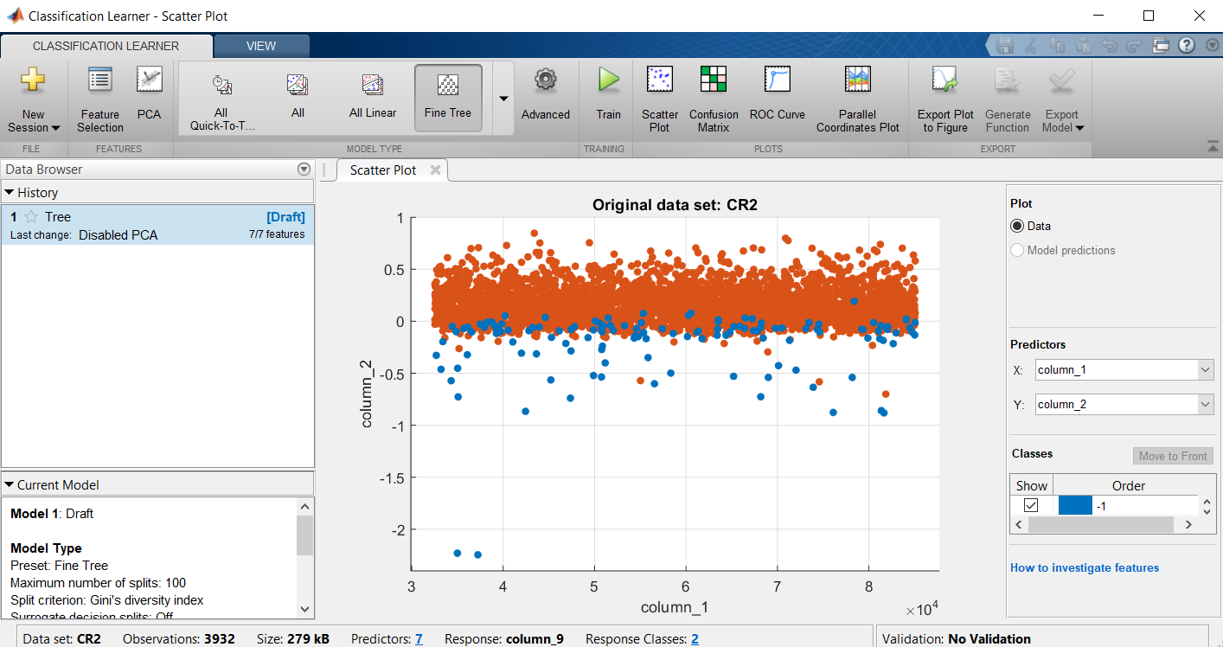
Exhibit 3

Slide 9
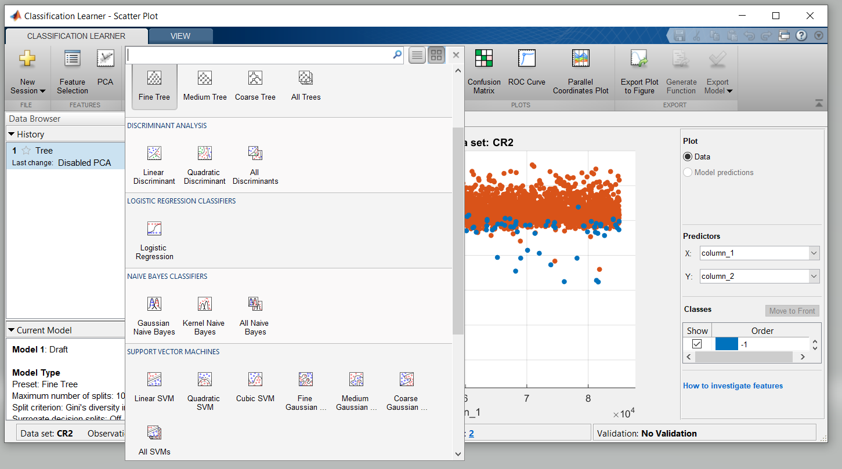
Exhibit 4

Slide 10
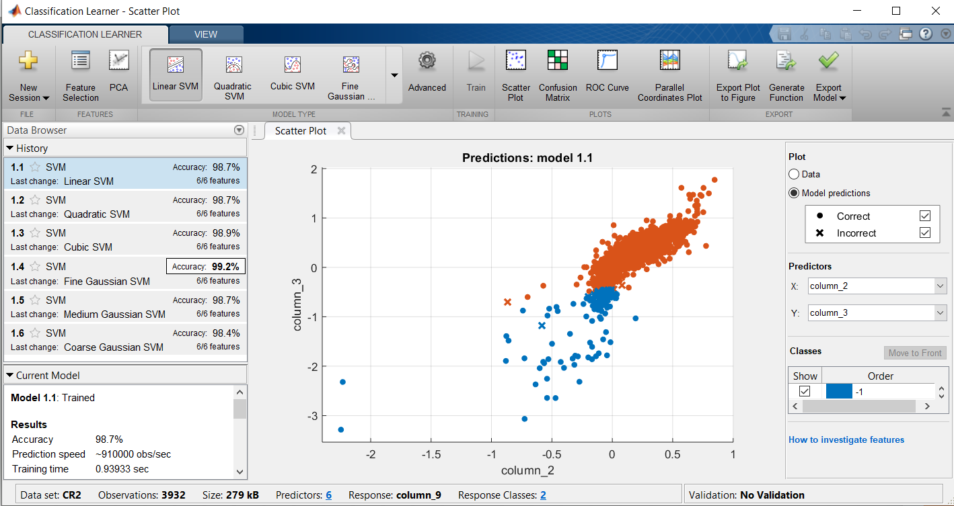
Exhibit 5

Slide 11
Checking the Confusion Matrix
Choose the Confusion Matrix option on the Classification Learner bar
The Confusion Matrix window will Appear (Exhibit 6)
The cells on the main diagonal correspond to correctly classified observations, while those off the main diagonal correspond to the incorrectly classified ones.
The sum over each of the two rows corresponds to the total true number of observations in each class: (94+36) for class -1, and (17+3785) for class 1.
It is now clear that the high accuracy value hides an unpleasant fact that while the fraction of correct observations for class 1 is very high, for class -1 it is not very good.
It has to do with the fact that the sample is unbalanced, i.e. the number of observations with true class 1 is about 25 times higher than the number of observations in class -1.
For a more realistic estimate balanced samples will be generated in the homework.

Slide 12
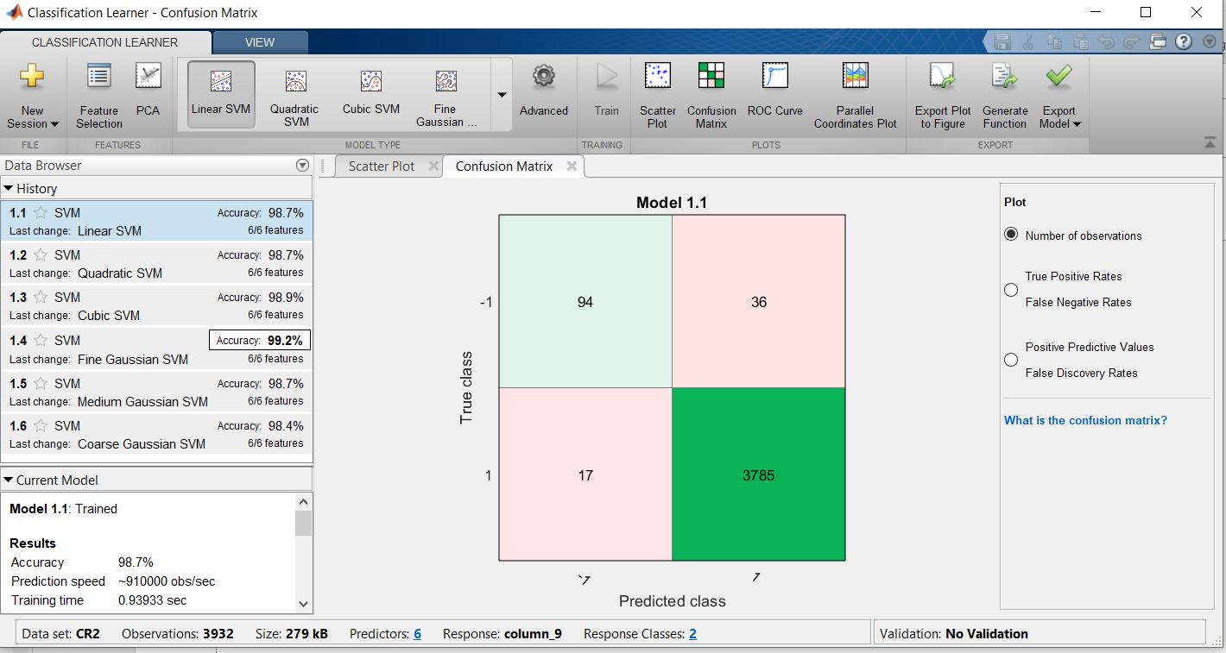
Exhibit 6

Slide 13
Same analysis with 5-fold validation
Next we perform the same analysis with the 5-fold validation.
To this end we start a new session, do all the same operations except that we choose the default 5-fold validation instead of no-validation.
Running the new training we generally get somewhat lower accuracy results, because cross validated results are averages over the different folds and are more realistic (Exhibit 7).
The confusion matrix for the best case with cross validation is also somewhat worse than in the no-validation case (Exhibit 8).

Slide 14
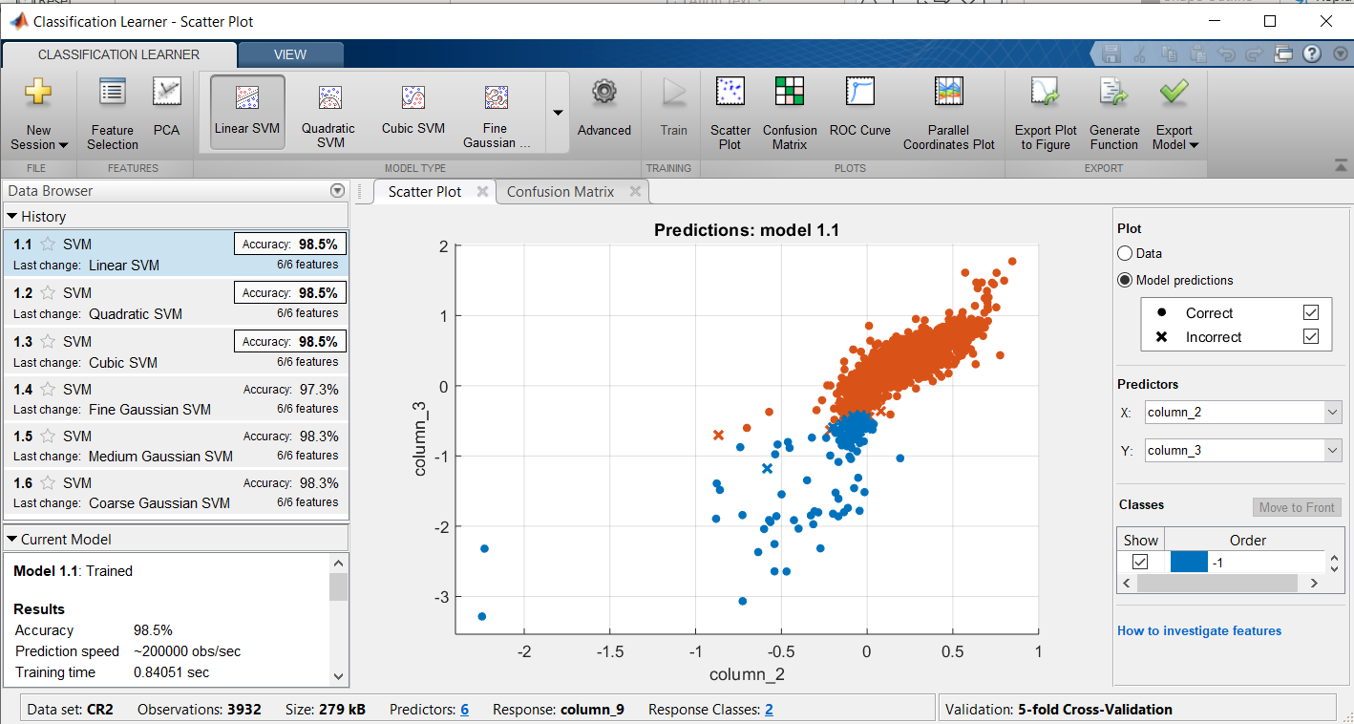
Exhibit 7

Slide 15
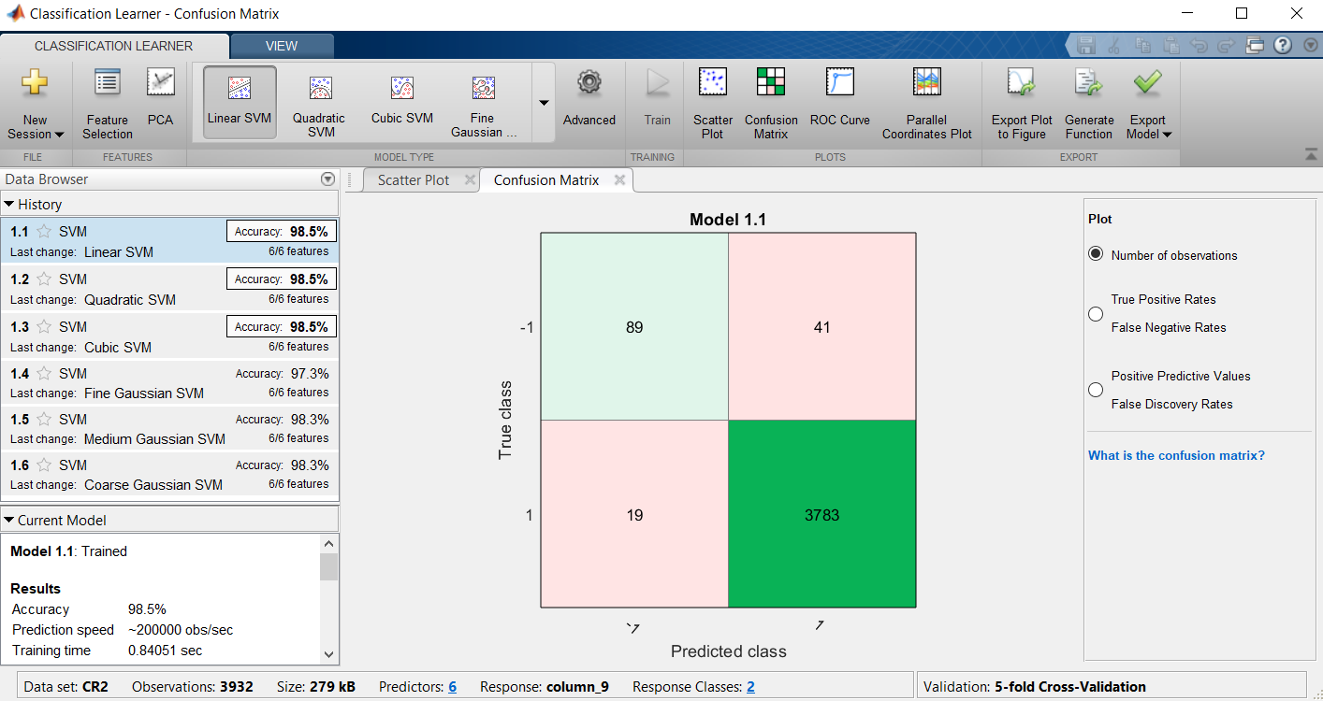
Exhibit 8

Slide 16
Exporting the Trained Model
Click on Export Model button and choose Export model option.
The “Export Model” window appears
Define your own name for the exported model, e.g. “Model1” and press OK
The icon for Model1 appears in the Workspace Window.
The following note appears in the Command Window:
Variables have been created in the base workspace.
Structure 'Model1' exported from Classification Learner.
To make predictions on a new predictor column matrix, X:
yfit = Model1.predictFcn(X)
For more information, see How to predict using an exported model.

Slide 17
Make Predictions for New Data
After you export a model to the workspace from Classification Learner, or run the code generated from the app, you get a trainedModel structure that you can use to make predictions using new data. The structure contains a classification object and a function for prediction. The structure allows you to make predictions for models that include principal component analysis (PCA).
To use the exported classifier to make predictions for new data, T, use the form:
yfit = C.predictFcn(T)
where C is the name of your variable, e.g., trainedModel.
Supply the data T in same data type as your training data used in the app (table or matrix).
If you supply a table, ensure it contains the same predictor names as your training data. The predictFcn ignores additional variables in tables. Variable formats (e.g. matrix or vector, data type) must match the original training data.
If you supply a matrix, it must contain the same predictor columns or rows as your training data, in the same order and format. Do not include a response variable, any variables that you did not import in the app, or other unused variables.
The output yfit contains a class prediction for each data point.
Examine the fields of the exported structure. For help making predictions, enter:
C.HowToPredict

Slide 18
Testing Out-of-Sample
To demonstrate out-of-sample testing of the trained model I created a file with a more balanced composition: 300 observations labeled 1 and 130 observations labeled -1. This file is called file CR3.xlsx.
Note that to be used in out-of-sample testing the file only has predictor variables (features). It cannot include the response variable.
Import it.
The vector of response variable values is in file RV1
Import it.

Slide 19
Out-of-Sample Prediction
Perform the prediction:
>> label = predict(Model1.ClassificationSVM,CR3);
As a result of this command the vector label will contain predicted values of classification using the trained model Model1 for the out-of-sample set CR3.
To assess the quality of classification create the out of sample confusion matrix based on the vector of the true values RV1 and predicted out-of-sample values in vector label.
>> confusionmat(RV1,label)
ans =
94 36
0 300

Slide 20
Conclusion
Note that the out-of-sample result is not very “out-of-sample” in this case, because we took it from the training set.
The example required in the homework would be more realistic, because the training sample will be more different from the testing set,

